Slide 1
Language Enrichment That Works!
Presented by Lili Dibai, Lee Glaesemann, Joël Johnson, and Sarah Arnold Martinez
January 30, 2020 Seidlitz Conference, What’s Working for ELs in Texas?
All content is property of Fort Bend ISD. No part of this publication may be reproduced without express written permission from Fort Bend ISD Multilingual Programs.

Slide 2
Getting to Know You!
How many of you are…
Elementary General Education Teachers
Elementary ESL Teachers
Elementary Bilingual/Dual Language Teachers
Secondary General Education Teachers
Secondary ESL Teachers
Specialists or Instructional Coaches
Campus or District Administrators
All content is property of Fort Bend ISD. No part of this publication may be reproduced without express written permission from Fort Bend ISD Multilingual Programs.

Slide 3
Does any of this look familiar?
State testing preparation materials/tutorials
Teaching straight from a textbook
Scouring the internet for materials
Insufficient instructional resources to meet the needs of all students, including English Learners (ELs)
Online programs as a SOLE means to language acquisition
All content is property of Fort Bend ISD. No part of this publication may be reproduced without express written permission from Fort Bend ISD Multilingual Programs.

Slide 4
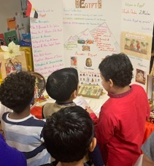
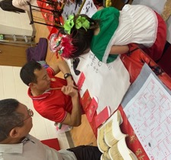
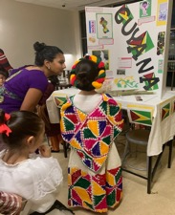
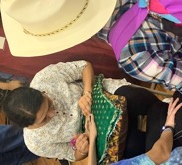
Welcome to Fort Bend ISD!
Eighth largest district in Texas
76,000 students
16% ELs
Most diverse in the nation
More than 90 languages and dialects spoken
All content is property of Fort Bend ISD. No part of this publication may be reproduced without express written permission from Fort Bend ISD Multilingual Programs.

Slide 5
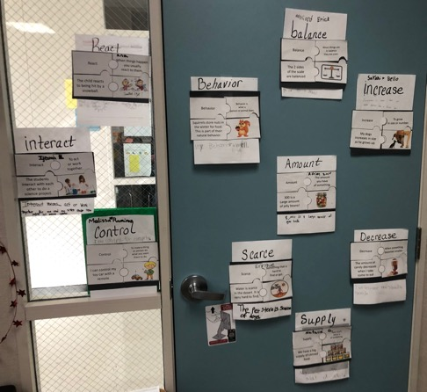
What's Our Story?
The FBISD curriculum supports the linguistic needs of all ELs.
The curriculum provides exemplars of sheltered instruction and a systematic approach to teaching vocabulary.
Curriculum
All content is property of Fort Bend ISD. No part of this publication may be reproduced without express written permission from Fort Bend ISD Multilingual Programs.

Slide 6
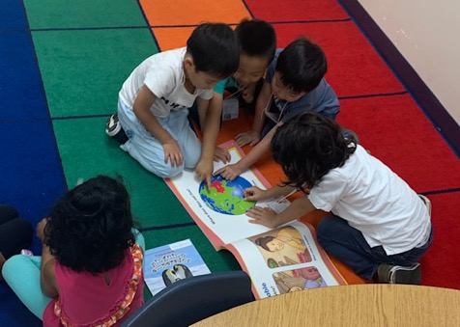
What's Our Story?
Today’s Focus
We recognized a need for ELs to engage in an enrichment curriculum whose focus is language acquisition.
We would like to share our process of developing a supplemental curriculum for K-12 English learners.
All content is property of Fort Bend ISD. No part of this publication may be reproduced without express written permission from Fort Bend ISD Multilingual Programs.

Slide 7
Step 1: Answering Our “Why” The Need for Supplemental EL Curriculum
Developing an equitable supplemental EL curriculum involved...
reviewing current state and federal guidelines
researching EL demographic trends by region
examining current and proposed resources
All content is property of Fort Bend ISD. No part of this publication may be reproduced without express written permission from Fort Bend ISD Multilingual Programs.

Slide 8
Step 2: Developing a Student Profile
We reviewed data sources such as TELPAS, Universal Screener, and teacher feedback in order to…
establish descriptors of ELs who would benefit from additional opportunities to acquire English
prepare a curriculum specific to ELs' linguistic and developmental needs
All content is property of Fort Bend ISD. No part of this publication may be reproduced without express written permission from Fort Bend ISD Multilingual Programs.

Slide 9
Step 3: Creation and Implementation of Supplemental Curriculum
Develop a curriculum whose content...
facilitates language acquisition
is consistent by program on any campus
provides for lesson deliveries, materials, and strategies that are appropriate and equitable
All content is property of Fort Bend ISD. No part of this publication may be reproduced without express written permission from Fort Bend ISD Multilingual Programs.

Slide 10
Step 4: Development of Supplemental Curriculum
Role of the EL supplemental curriculum writer:
Collaborate with EL coordinators on turning the "blueprint" into actual curriculum.
Prepare daily lessons that are comprehensible to teachers with or without a strong background in sheltered instruction
Develop learning experiences that are language-rich and of high interest to students
All content is property of Fort Bend ISD. No part of this publication may be reproduced without express written permission from Fort Bend ISD Multilingual Programs.

Slide 11
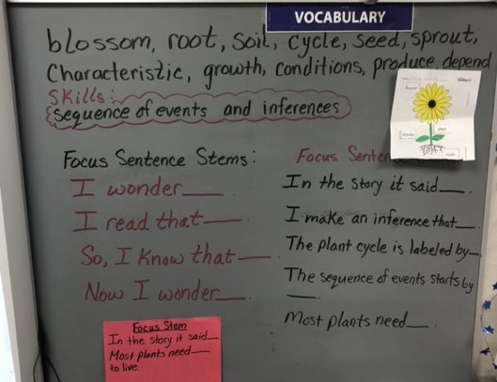
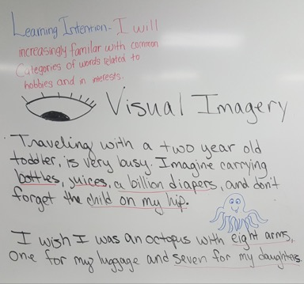
Language-rich/Sheltered Classroom Experiences Incorporating Four Domains of Language
All content is property of Fort Bend ISD. No part of this publication may be reproduced without express written permission from Fort Bend ISD Multilingual Programs.

Slide 12
Appropriate Themes/Content in Connection with Specific Language Functions
Secondary ESL
Elementary ESL
Thematic-Based
Instructional Focus
Building Community
Job/Occupation/Money
Interests/Hobbies, Games/Sports, Entertainment
HS and College in the U.S.
Content-Based Instructional Focus
Language development
Reading comprehension
Vocabulary development
All content is property of Fort Bend ISD. No part of this publication may be reproduced without express written permission from Fort Bend ISD Multilingual Programs.

Slide 13
Focus on the ELPS: Speaking and Writing
All content is property of Fort Bend ISD. No part of this publication may be reproduced without express written permission from Fort Bend ISD Multilingual Programs.

Slide 14
Alignment to District Curriculum Structure
All content is property of Fort Bend ISD. No part of this publication may be reproduced without express written permission from Fort Bend ISD Multilingual Programs.

Slide 15
Curriculum Training for Administrators, Facilitators, and Teachers
Instructional Expectations and Responsibilities
EL Supplemental Program Offerings
Curricular Structures
Instructional Coaching
Instructional Routines
Instructional Resources
All content is property of Fort Bend ISD. No part of this publication may be reproduced without express written permission from Fort Bend ISD Multilingual Programs.

Slide 16
ESL Rising Kinder and Rising 1st
Elem. ESL Enrichment Program
Enrolled in Pre-K or Kindergarten.
Eligible to participate or will continue to participate in the FBISD ESL program in Kindergarten or 1st Grade.
All students must have qualified and have parent permission for the ESL program prior to registering for the supplemental program.
All content is property of Fort Bend ISD. No part of this publication may be reproduced without express written permission from Fort Bend ISD Multilingual Programs.

Slide 17
Elem. ESL Enrichment Program
Newcomer 2nd – 6th
Enrolled in 1st-5th grade
Born outside the USA
Have participated in the FBISD ESL program for 3 years or fewer
Have parent permission prior to registering for the supplemental program
Teacher recommendation based on level of English language proficiency
All content is property of Fort Bend ISD. No part of this publication may be reproduced without express written permission from Fort Bend ISD Multilingual Programs.

Slide 18
Elem. ESL Enrichment Program
Rising Stars 2nd – 6th
Enrolled in 1st-5th grade
Two years or more and continues to participate in the FBISD ESL program
Have parent permission prior to registering for the supplemental program
Teacher recommendation based on level of English language proficiency
All content is property of Fort Bend ISD. No part of this publication may be reproduced without express written permission from Fort Bend ISD Multilingual Programs.

Slide 19
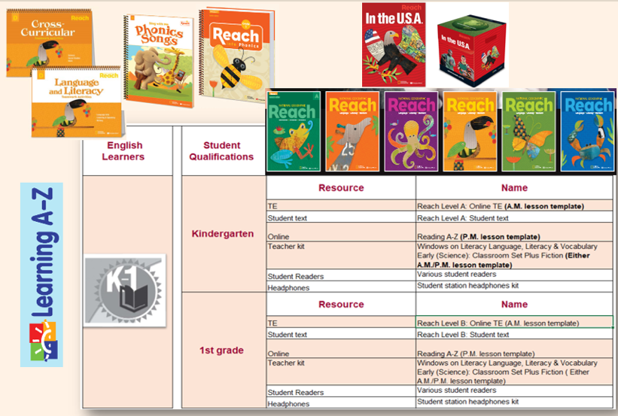
ESL Supplemental Resources
All content is property of Fort Bend ISD. No part of this publication may be reproduced without express written permission from Fort Bend ISD Multilingual Programs.

Slide 20
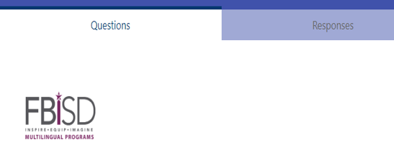
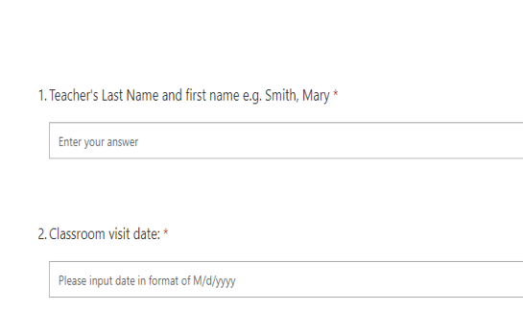
Instructional Support
Instructional Support
Daily instructional visits and conversations (face to face or virtual)
Purposeful number of classroom visits
Lesson Planning/Delivery
General overview of authentic English language development through content areas
Small group instruction
Balanced Literacy
Student Growth
Formative Assessment
Progress Reports focused on output domains of Speaking and Writing
All content is property of Fort Bend ISD. No part of this publication may be reproduced without express written permission from Fort Bend ISD Multilingual Programs.

Slide 21
Bilingual Rising Kinder and Rising 1st
Enrolled in Pre-K or Kindergarten.
Eligible to participate or will continue to participate in the FBISD Bilingual Program in Kindergarten or 1st Grade.
All students must have qualified and have parent permission for the Bilingual Program prior to registering for the supplemental program.
All content is property of Fort Bend ISD. No part of this publication may be reproduced without express written permission from Fort Bend ISD Multilingual Programs.

Slide 22
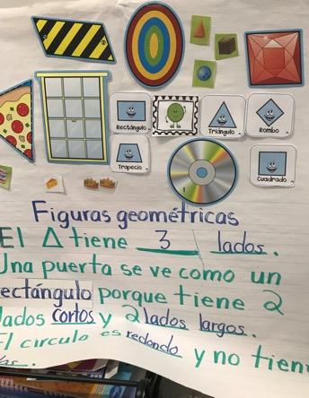
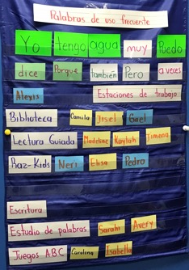
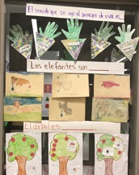
Bilingual Rising Kinder & 1st Schedule
Interdisciplinary Approach
English Language and Literacy Development Time
Spanish Language Arts
Literacy within the Content Areas
Social Studies
Math
Science
All content is property of Fort Bend ISD. No part of this publication may be reproduced without express written permission from Fort Bend ISD Multilingual Programs.

Slide 23
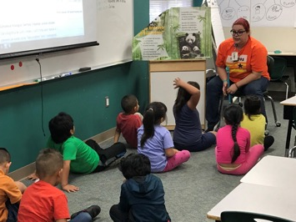
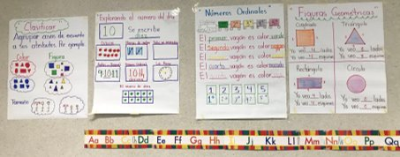
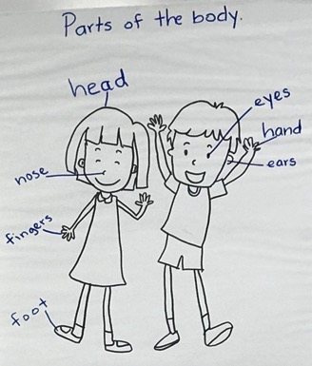
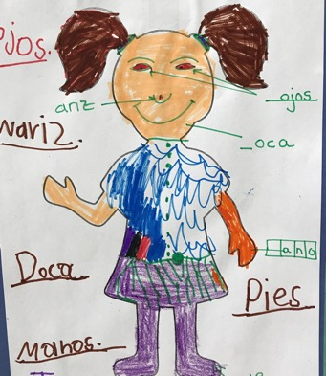
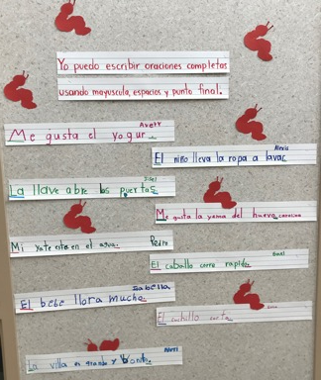
Bilingual Rising Kinder & 1st Curriculum
All content is property of Fort Bend ISD. No part of this publication may be reproduced
without express written permission from Fort Bend ISD Multilingual Programs.
Mathematics
Social Studies
Science
SLAR
ELLD

Slide 24
Balanced Literacy Approach
The bilingual supplemental program utilizes a balanced literacy approach.
All content is property of Fort Bend ISD. No part of this publication may be reproduced without express written permission from Fort Bend ISD Multilingual Programs.

Slide 25
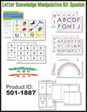
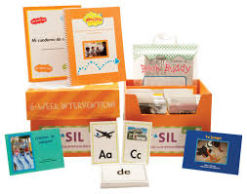
Bilingual Resources
All content is property of Fort Bend ISD. No part of this publication may be reproduced without express written permission from Fort Bend ISD Multilingual Programs.

Slide 26
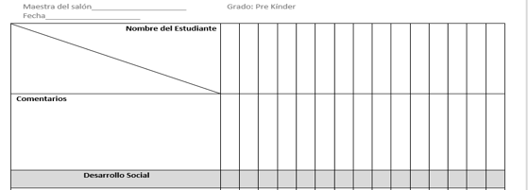
Bilingual Assessments
Pre- and Post- Assessment
Areas of Focus
Social Skills Development
Reading/Writing Development
Reading Comprehension Development
English Language and Literacy Development
Mathematics Development
All content is property of Fort Bend ISD. No part of this publication may be reproduced without express written permission from Fort Bend ISD Multilingual Programs.

Slide 27
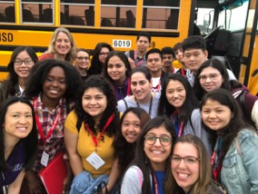
Secondary ESL
When writing this curriculum, we tried to consider the developmental needs of our middle and high school students.
Our focus was to create a linguistically and age-appropriate curriculum.
All content is property of Fort Bend ISD. No part of this publication may be reproduced without express written permission from Fort Bend ISD Multilingual Programs.

Slide 28
Structure
Middle School
Building Community
Concept 1-Culture | Compare/Contrast
Concept 2-Family | Compare/Contrast
Concept 3-Home | Compare/Contrast
Interests/Hobbies, Games/Sports, Entertainment
Concept 1-Interests/Hobbies | Sequence
Concept 2-Sports, Entertainment | Sequence
Job/Occupation/Money
Concept 1-Jobs/Occupations | Cause/Effect
Concept 2-Money | Cause/Effect
All content is property of Fort Bend ISD. No part of this publication may be reproduced without express written permission from Fort Bend ISD Multilingual Programs.

Slide 29
Structure
High School
Building Community
Concept 1-Culture | Compare/Contrast
Concept 2-Family | Compare/Contrast
Concept 3-Home | Compare/Contrast
Job/Occupation/Money
Concept 1-Jobs/Occupations | Cause/Effect
Concept 2-Money | Cause/Effect
High School and College in the US
Concept 1-High School in the US | Sequence
Concept 2-College | Sequence
All content is property of Fort Bend ISD. No part of this publication may be reproduced without express written permission from Fort Bend ISD Multilingual Programs.

Slide 30
Instructional Model
Workshop Model
Opening Structure
Mini Lesson
Work Time
Debrief
All content is property of Fort Bend ISD. No part of this publication may be reproduced without express written permission from Fort Bend ISD Multilingual Programs.

Slide 31
Instructional Model: Opening Structure
Sets the instructional purpose for the day
Can be used to assess background knowledge.
Can be used to activate prior knowledge, building background knowledge, making connections, etc.
Time to review the written and displayed learning intention, success criteria & key vocabulary.
All content is property of Fort Bend ISD. No part of this publication may be reproduced without express written permission from Fort Bend ISD Multilingual Programs.

Slide 32
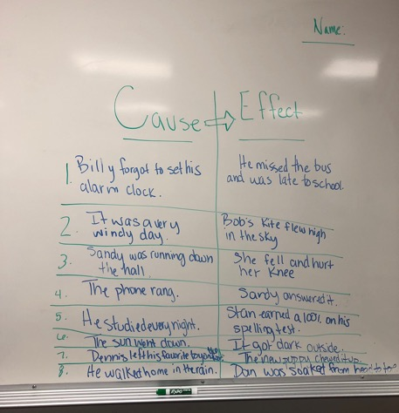
Instructional Model: Mini Lesson
Demonstration/Models
Whole Group Instruction
Small Group Instruction
Inquiry / Experiment
Shared Writing
Shared Reading/Interactive Read Aloud
All content is property of Fort Bend ISD. No part of this publication may be reproduced without express written permission from Fort Bend ISD Multilingual Programs.

Slide 33
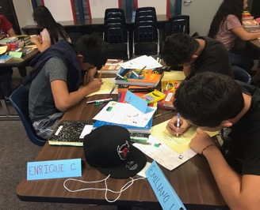
Instructional Model: Application
Focused on a single skill or well-paired skills
Student led learning through intentional small group and independent work
Structured student talk to support thinking
Student share time
Teacher as facilitator
Stations
All content is property of Fort Bend ISD. No part of this publication may be reproduced without express written permission from Fort Bend ISD Multilingual Programs.

Slide 34
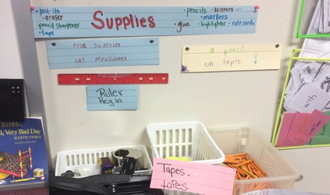
Stations: Example
Listening/Speaking station:
With your partner, use the Picture Dictionary pages 18-19 to identify and make/print 10 labels for the classroom.
Place labels where they belong in the classroom with tape.
Play I Spy with your partner using sentence frames and all identified objects in the room. * Teacher will review how to play "I SPY" and use stem: I spy something _______ and it is _________ .
All content is property of Fort Bend ISD. No part of this publication may be reproduced without express written permission from Fort Bend ISD Multilingual Programs.

Slide 35
Stations: Example
Reading/Writing station:
Use sentence stems and vocabulary lists (verbs) to describe the function of different items in the classroom (Picture Dictionary Pages 18-23).
All content is property of Fort Bend ISD. No part of this publication may be reproduced without express written permission from Fort Bend ISD Multilingual Programs.

Slide 36
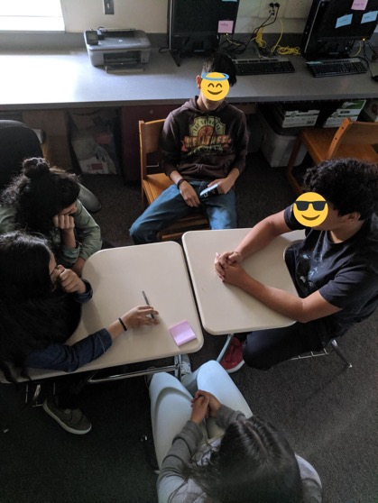
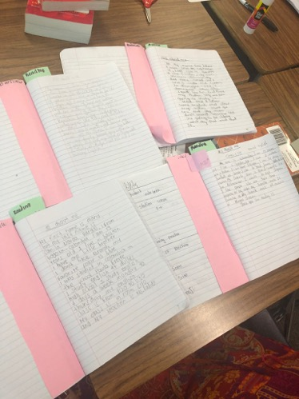
Focus on output
All content is property of Fort Bend ISD. No part of this publication may be reproduced without express written permission from Fort Bend ISD Multilingual Programs.

Slide 37
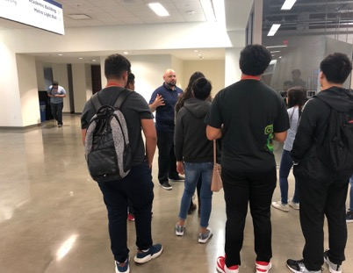
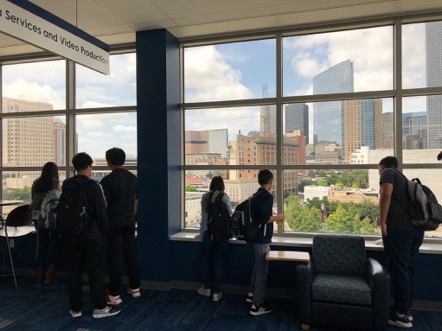
College Visit!
All content is property of Fort Bend ISD. No part of this publication may be reproduced without express written permission from Fort Bend ISD Multilingual Programs.

Slide 38
Fidelity and Refinement
Equity across campuses
Classroom observations
Survey data (parents, administrators, teachers, students)
Continuous improvement
Curriculum writers as teachers
Curriculum refinement at the end of a program cycle
All content is property of Fort Bend ISD. No part of this publication may be reproduced without express written permission from Fort Bend ISD Multilingual Programs.

Slide 39
Success!
End goal: Create a supplemental curriculum that accelerates English language development.
Observed Success:
High level of student engagement at all grade levels
Consistent attendance throughout supplemental programs
Student ownership of English language development
All content is property of Fort Bend ISD. No part of this publication may be reproduced without express written permission from Fort Bend ISD Multilingual Programs.

Slide 40
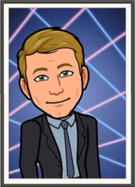
Lili Dibai
Elem. ESL Program Coordinator
Lee Glaesemann
Elem. ESL Program Coordinator
Sarah Arnold Martinez
Bilingual Program Coordinator
Joël Johnson
Sec. ESL Program Coordinator
All content is property of Fort Bend ISD. No part of this publication may be reproduced without express written permission from Fort Bend ISD Multilingual Programs.

